Slide 1


Introduction to Linear Regression

Slide 2
Table of Contents
What is regression?
Mathematical Representation of regression (GI)
How to model the data?
Performance metric of a model (R-square, MSE, MAE)

Slide 3
What is Regression ?
Regression is a statistical method used to analyze and model the relationship between a dependent variable and one or more independent variables
In other words A regression model determines a relationship between an independent variable and a dependent variable, by providing a function. Formulating a regression analysis helps you predict the effects of the independent variable on the dependent one.

Slide 4
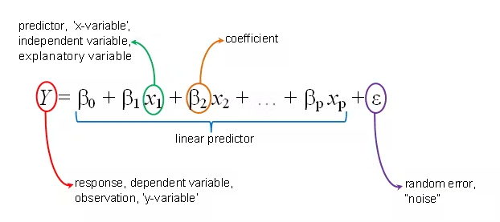
Mathematical Formula for Regression
Linear Regression representation consists of a linear equation that combines a specific set of input values (x), the solution to which is the predicted output (y) for that set of input values (y).
The linear equation assigns one scale factor to each input value or column, called a coefficient and represented by the capital Greek letter Beta (B).

Slide 5
Mathematical Formula for Regression
One additional coefficient is also added, giving the line an additional degree of freedom (e.g. moving up and down on a two-dimensional plot) and is often called the intercept or the bias coefficient.
B0 - represents the intercept
B1 - represents the coefficient
x - represents the independent variable
y - represents the output or the dependent variable

Slide 6
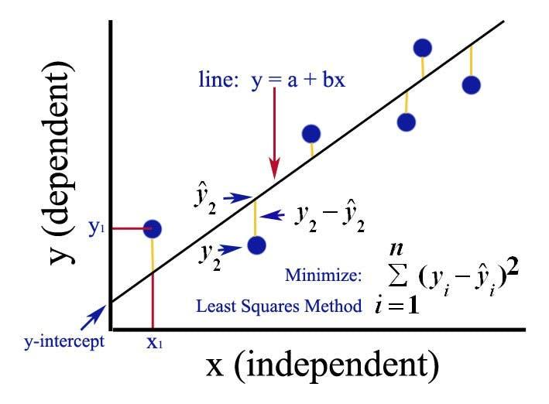
Ordinary Least Squares
When we have more than one input we can use Ordinary Least Squares to estimate the values of the coefficients.
The Ordinary Least Squares procedure seeks to minimize the sum of the squared residuals.

Slide 7
Ordinary Least Squares
This means that given a regression line through the data we calculate the distance from each data point to the regression line, square it, and sum all of the squared errors together.
This is the quantity that ordinary least squares seeks to minimize

Slide 8
Linear-Regression Modelling
The objective of linear regression is to find the best fitting line through the data that minimizes the sum of the squared distances between the observed data and the predicted values.

Slide 9
Linear-Regression Modelling
Here are the steps to model linear regression:
Collect data: Gather a set of data with a dependent variable and one or more independent variables.
Visualize data: Plot the data to visualize the relationship between the dependent variable and independent variables.
Choose a model: Select a linear regression model that fits the data.

Slide 10
Linear-Regression Modelling
Estimate coefficients: Estimate the coefficients of the model using a method such as the least squares method.
Evaluate the model: Evaluate the model's performance using metrics such as the R-squared value, which measures how well the model fits the data.
Make predictions: Use the model to make predictions for new data points.

Slide 11
Performance Metrics of Regression Models

Slide 12
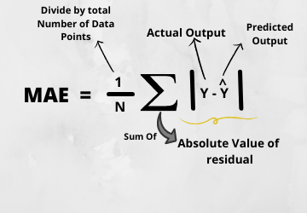
Mean Absolute Error(MAE)
MAE is a very simple metric which calculates the absolute difference between actual and predicted values.
To better understand, let’s take an example you have input data and output data and use Linear Regression, which draws a best-fit line.

Slide 13
Mean Absolute Error(MAE)
Now you have to find the MAE of your model which is basically a mistake made by the model known as an error.
Now find the difference between the actual value and predicted value that is an absolute error but we have to find the mean absolute of the complete dataset.

Slide 14
Mean Absolute Error(MAE)
so, sum all the errors and divide them by a total number of observations And this is MAE. And we aim to get a minimum MAE because this is a loss

Slide 15
Mean Absolute Error(MAE)
Advantages of MAE
The MAE you get is in the same unit as the output variable.
It is most Robust to outliers.
Disadvantages of MAE
The graph of MAE is not differentiable so we have to apply various optimizers like Gradient descent which can be differentiable.

Slide 16
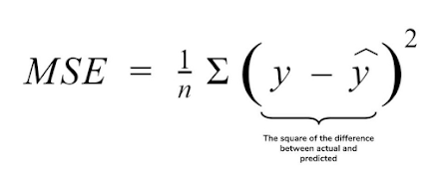
Mean Squared Error(MSE)
MSE is a most used and very simple metric with a little bit of change in mean absolute error. Mean squared error states that finding the squared difference between actual and predicted value.
So, above we are finding the absolute difference and here we are finding the squared difference.
What actually the MSE represents? It represents the squared distance between actual and predicted values. we perform squared to avoid the cancellation of negative terms and it is the benefit of MSE.

Slide 17
Mean Squared Error(MSE)
What actually the MSE represents?
It represents the squared distance between actual and predicted values. we perform squared to avoid the cancellation of negative terms and it is the benefit of MSE.

Slide 18
Mean Squared Error(MSE)
Advantages of MSE
The graph of MSE is differentiable, so you can easily use it as a loss function.
Disadvantages of MSE
The value you get after calculating MSE is a squared unit of output. for example, the output variable is in meter(m) then after calculating MSE the output we get is in meter squared.
If you have outliers in the dataset then it penalizes the outliers most and the calculated MSE is bigger. So, in short, It is not Robust to outliers which were an advantage in MAE.

Slide 19
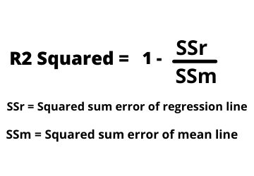
R-Squared Error
R2 score is a metric that tells the performance of your model, not the loss in an absolute sense that how many wells did your model perform.
In contrast, MAE and MSE depend on the context as we have seen whereas the R2 score is independent of context.

Slide 20
R-Squared Error
So, with help of R squared we have a baseline model to compare a model which none of the other metrics provides. The same we have in classification problems which we call a threshold which is fixed at 0.5. So basically R2 squared calculates how must regression line is better than a mean line.

Slide 21
R-Squared Error
Hence, R2 squared is also known as Coefficient of Determination or sometimes also known as Goodness of fit.

Slide 22


